Slide 1
Learning & Development Enabling development, Impacting growth…
Apache Spark

Slide 2
Spark Core
RDD Basics
Creating RDDs in Spark.
RDD Operations.
Passing Functions to Spark.
Transformations and Actions in Spark

Slide 3
RDD Basics
Resilient Distributed Dataset
Spark’s primary abstraction
A distributed collection of items called elements, could be KV pairs or anything else
RDDs are immutable
RDDs can contain any type of Python, Java, or Scala objects
Transformations and Actions can be performed on RDDs
RDD can be created from HDFS file, local file, parallelized collection, JSON file etc.

Slide 4
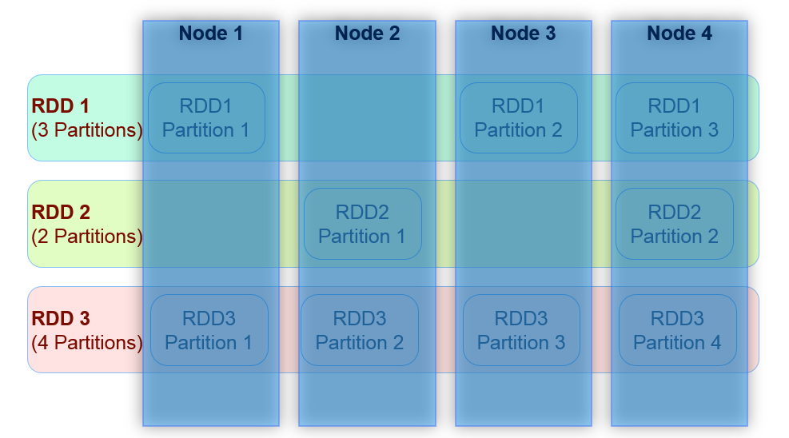
RDD Basics
RDD Internal Representation
Image Source: Datafacts Company

Slide 5
Creating RDDs in Spark.
RDDs can be created in two ways.
Create an RDD from an external file.
Create an RDD from a list of Strings
Below example loads a text file as an RDD.
textFile() method in Python
lines = sc.textFile("/path/to/README.md")
textFile() method in Scala
val lines = sc.textFile("/path/to/README.md")
Notes:
lines = sc.textFile("/path/to/README.md") #python
val lines = sc.textFile("/path/to/README.md") # Scala

Slide 6
Creating RDDs in Spark.
Below example Create an RDD from a list of Strings
It can be created by parallelizing collections in your driver
parallelize() method in Python
lines = sc.parallelize(["pandas", "i like pandas"])
parallelize() method in Scala
val lines = sc.parallelize(List("pandas", "i like pandas"))
Notes:
parallelize() method in Python
lines = sc.parallelize(["pandas", "i like pandas"])
parallelize() method in Scala
val lines = sc.parallelize(List("pandas", "i like pandas"))

Slide 7
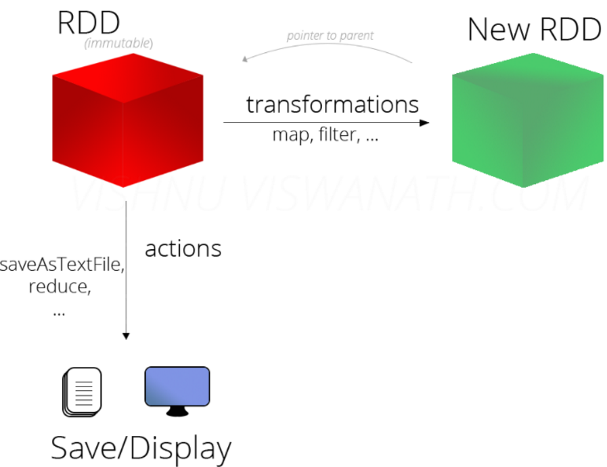
RDD Operations
RDD Operations
Transformations
Actions
Lazy Evaluation
Image Source: http://vishnuviswanath.com/spark_rdd.html

Slide 8
RDD Operations
Transformations:
Operate on an RDD and return a new RDD: Are lazily evaluated
Actions
Return a value after running a computation on a RDD.
The DAG is evaluated only when an action takes place.
Lazy Evaluation
Evaluation happens only when an action is called.
Deferring decisions will yield more information at runtime to better optimize the program
So a Spark program actually starts executing when an action is called.

Slide 9
RDD Operations
Transformations:
Transformations are operations on RDDs that return a new RDD
filter() transformation in Python
inputRDD = sc.textFile("log.txt")
errorsRDD = inputRDD.filter(lambda x: "error" in x)
filter() transformation in Scala
val inputRDD = sc.textFile("log.txt")
val errorsRDD = inputRDD.filter(line => line.contains("error"))
Notes:
Note that the filter() operation does not mutate the existing inputRDD. Instead, it returns a pointer to an entirely new RDD.

Slide 10
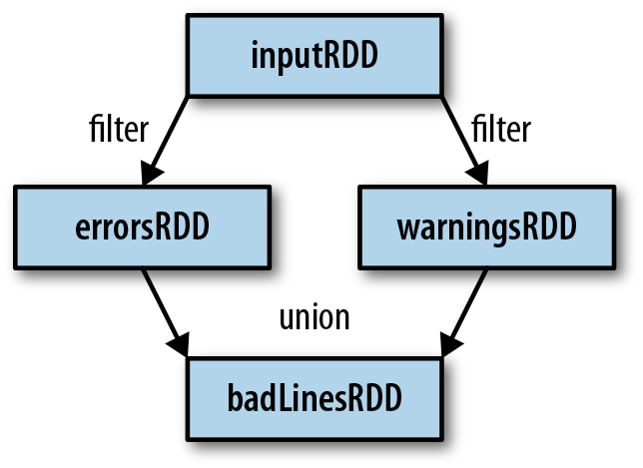
RDD Operations
Transformations: lineage graph
It uses this information to compute each RDD on demand and to recover lost data if part of a persistent RDD is lost
RDD lineage graph created during log analysis
Image Source:LearningSpark(o'reilly media)

Slide 11
Transformations and Actions in Spark
Spark Operations
Transformations (define a new RDD) | Map() filter() Sample() groupByKey() reduceByKey() sortByKey() flatMap() union() join() cogroup() cross mapValues()
Actions (return a result to driver program) | Collect() Reduce() Count() Save() lookupKey()
Notes:
class SearchFunctions(val query: String) {
def isMatch(s: String): Boolean = {
s.contains(query)
}
def getMatchesFunctionReference(rdd: RDD[String]): RDD[String] = {
// Problem: "isMatch" means "this.isMatch", so we pass all of "this"
rdd.map(isMatch)
}
def getMatchesFieldReference(rdd: RDD[String]): RDD[String] = {
// Problem: "query" means "this.query", so we pass all of "this"
rdd.map(x => x.split(query))
}
def getMatchesNoReference(rdd: RDD[String]): RDD[String] = {
// Safe: extract just the field we need into a local variable
val query_ = this.query
rdd.map(x => x.split(query_))
}
}

Slide 12
What is Spark streaming?
What is Spark streaming?
Spark streaming : How it works ?
Spark DStreams
A Twitter example
Fault-tolerance
Q & A

Slide 13
What is Spark Streaming?
Framework for large scale stream processing
Scales to 100s of nodes
Can achieve second scale latencies
Integrates with Spark’s batch and interactive processing
Provides a simple batch-like API for implementing complex algorithm
Can absorb live data streams from Kafka, Flume, ZeroMQ, etc.
Spark streaming is an extension of the core Spark API that enables scalable, high-throughput stream processing of live data streams.

Slide 14
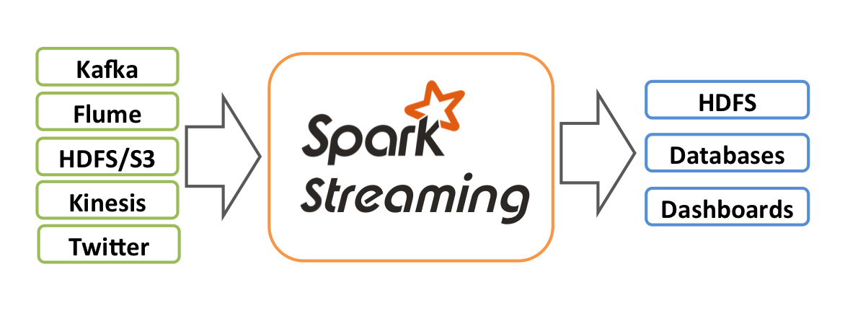
What is Spark Streaming?
Data can be ingested from many sources like Kafka, Flume, Twitter, ZeroMQ, Kinesis, or TCP sockets
Source: Databricks

Slide 15
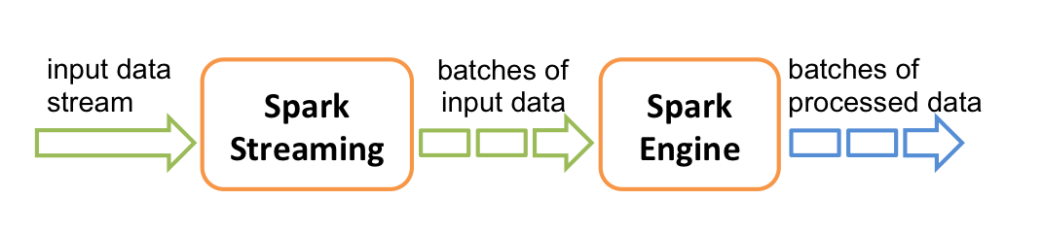
Spark Streaming : How it Works ?
Spark Streaming receives live input data streams and divides the data into batches.
Each batch is processed by the Spark engine to generate the final stream of results.
Source: Databricks

Slide 16
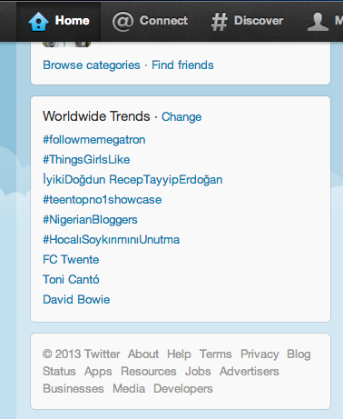
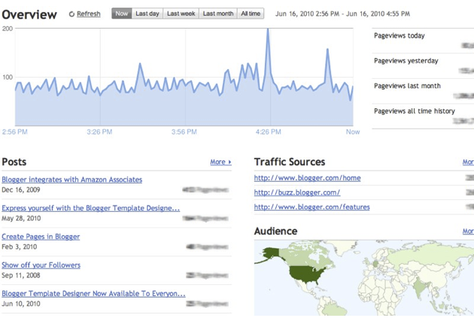
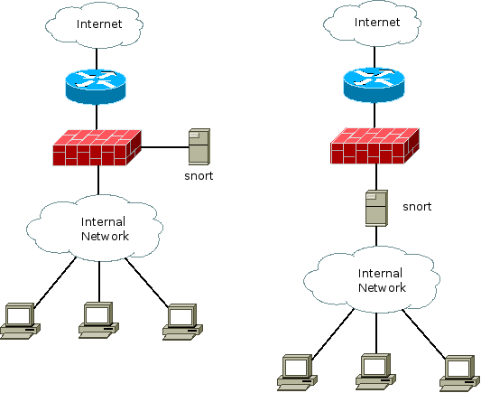
Spark Streaming : How it Works ?
Motivation
Many important applications must process large streams of live data and provide results in near-real-time
Social network trends
Website statistics
Intrustion detection systems
Require large clusters to handle workloads
Require latencies of few seconds
Source: Databricks

Slide 17
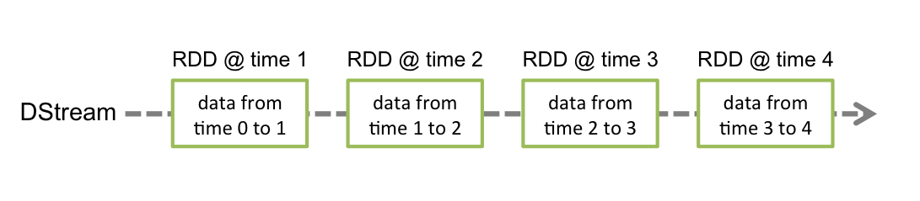
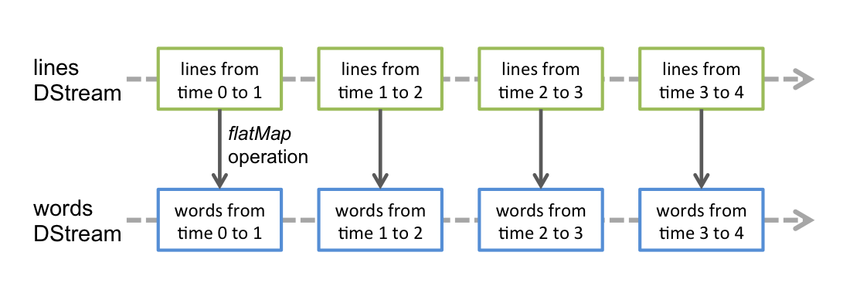
Spark DStream
Run a streaming computation as a series of very small, deterministic batch jobs

Slide 18
Spark DStreams
Run a streaming computation as a series of very small, deterministic batch jobs
Chop up the live stream into batches of X seconds
Spark treats each batch of data as RDDs and processes them using RDD operations
Finally, the processed results of the RDD operations are returned in batches
Live data stream
Spark
Streaming
batches of X seconds
Spark
processed results

Slide 19
Spark DStreams
Run a streaming computation as a series of very small, deterministic batch jobs
Batch sizes as low as ½ second, latency of about 1 second
Potential for combining batch processing and streaming processing in the same system
Live data stream
Spark
Streaming
batches of X seconds
Spark
processed results

Slide 20
Spark DStream
Out of the box Spark provide
Kafka
HDFS
Flume
Akka Actors
Raw TCP sockets
Very easy to write a receiver for your own data source

Slide 21

Example – Get hashtags from Twitter
val tweets = ssc.twitterStream()
DStream: a sequence of RDDs representing a stream of data
Twitter Streaming API
batch @ t+1
batch @ t
batch @ t+2
tweets DStream
stored in memory as an RDD (immutable, distributed)
Source:datadricks

Slide 22
Example – Get hashtags from Twitter
val tweets = ssc.twitterStream()
val hashTags = tweets.flatMap (status => getTags(status))
new DStream
transformation: modify data in one DStream to create another DStream
batch @ t
batch @ t+1
batch @ t+2
tweets DStream
flatMap
flatMap
flatMap
hashTags Dstream
[#cat, #dog, … ]
…
new RDDs created for every batch
Source:datadricks

Slide 23
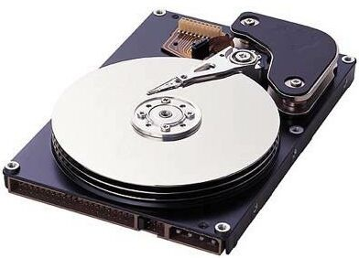
Example – Get hashtags from Twitter
val tweets = ssc.twitterStream()
val hashTags = tweets.flatMap (status => getTags(status))
hashTags.saveAsHadoopFiles("hdfs://...")
output operation: to push data to external storage
batch @ t
batch @ t+1
batch @ t+2
tweets DStream
flatMap
flatMap
flatMap
hashTags DStream
save
save
save
every batch saved to HDFS
Source:datadricks

Slide 24
Example – Get hashtags from Twitter
val tweets = ssc.twitterStream()
val hashTags = tweets.flatMap (status => getTags(status))
hashTags.foreach(hashTagRDD => { ... })
foreach: do whatever you want with the processed data
batch @ t
batch @ t+1
batch @ t+2
tweets DStream
flatMap
flatMap
flatMap
hashTags DStream
foreach
foreach
foreach
Write to database, update analytics UI, do whatever you want
Source:datadricks

Slide 25
Example – Scala
Scala Streaming Example
val tweets = ssc.twitterStream()
val hashTags = tweets.flatMap (status => getTags(status))
hashTags.saveAsHadoopFiles("hdfs://...")

Slide 26
Fault-tolerance: Worker
RDDs remember the operations that created them
Batches of input data are replicated in memory for fault-tolerance
Data lost due to worker failure, can be recomputed from replicated input data
All transformed data is fault-tolerant, and exactly-once transformations
tweets
RDD
input data replicated
in memory
flatMap
hashTags
RDD
lost partitions recomputed on other workers

Slide 27
Window-based Transformations
val tweets = ssc.twitterStream()
val hashTags = tweets.flatMap (status => getTags(status))
val tagCounts = hashTags.window(Minutes(1), Seconds(5)).countByValue()
sliding window operation
window length
sliding interval
window length
DStream of data
sliding interval

Slide 28
Q & A

Slide 29
Thank You
Review Date | 12-May-2016
Version | 1.0
Next Review Due | 12-May-2016

